Slide 1

SonarQube
Setting up Projects Jenkins & SonarQube
Presented By :
Amrit Choudhary

Slide 2

On boarding ANT projects
Pre- Requisites
Install ANT 1.10.7 on your machine/remote host where ANT job would run.
https://downloads.apache.org/ant/binaries/apache-ant-1.10.7-bin.zip
Set environment variable ANT_HOME
Verify ANT version cmd: ant -version
JDK min’m 1.8
Verify java version cmd : java -version

Slide 3
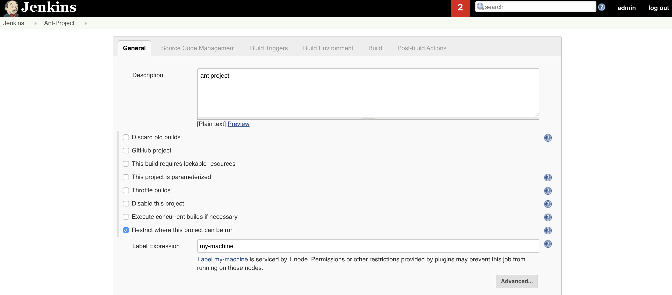
On boarding ANT project on Jenkins
Follow the Video & Snapshots for reference

Slide 4
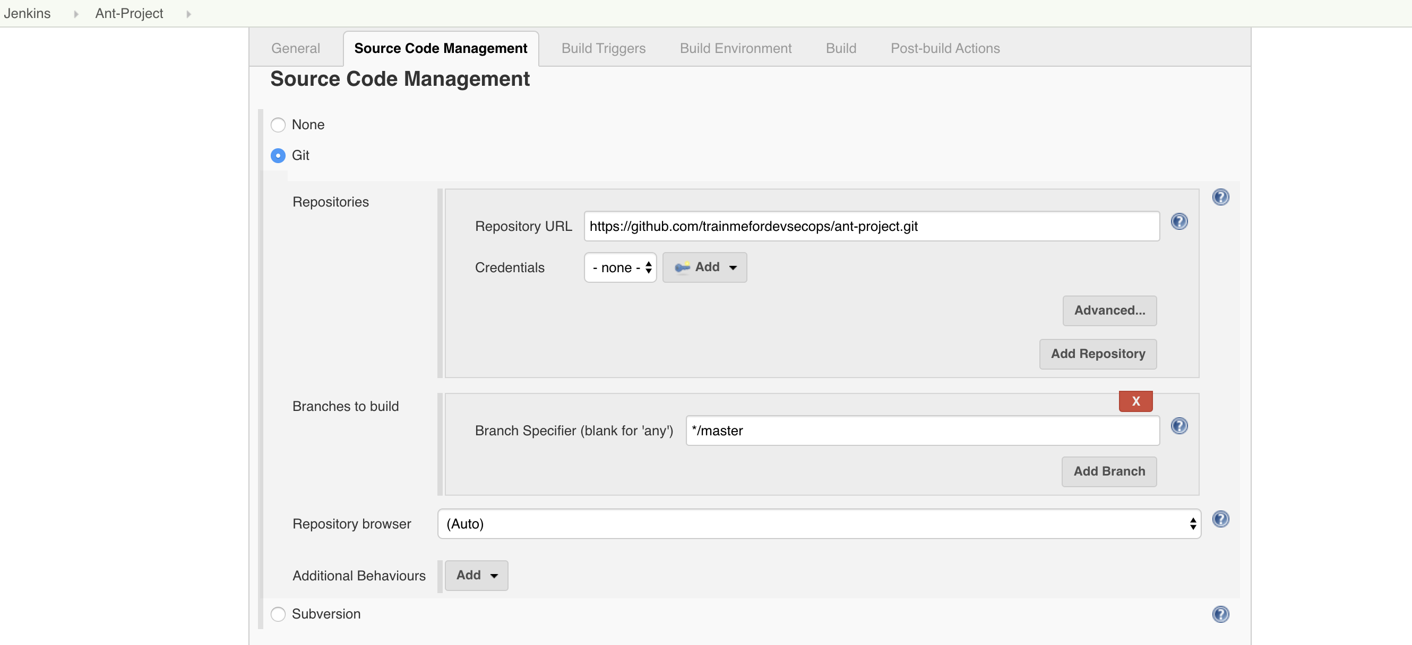
On boarding ANT project on Jenkins Provide ANT git repo url

Slide 5
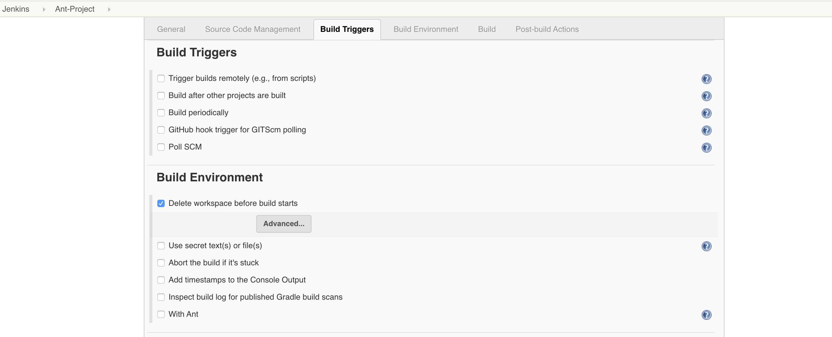
On boarding ANT project on Jenkins

Slide 6
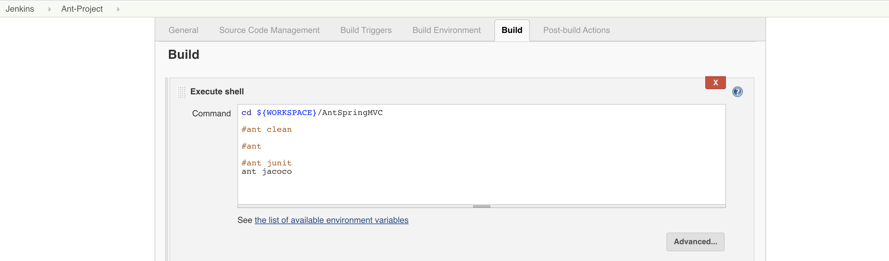
On boarding ANT project on Jenkins

Slide 7
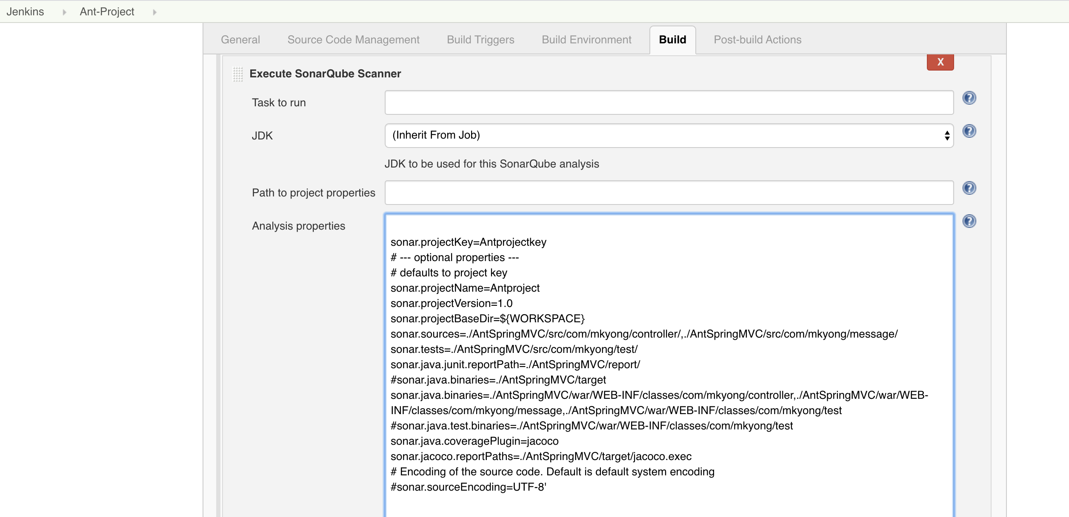
On boarding ANT project on Jenkins

Slide 8
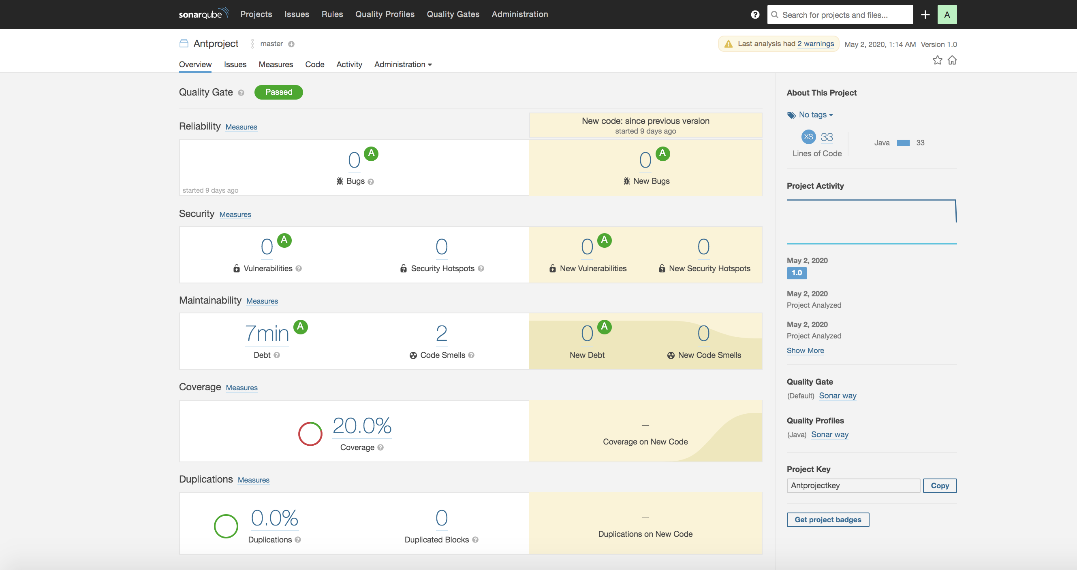
Run Jenkins Ant Job : Final Result SonarQube

Slide 9
Congrats !!!
ANT Project is on boarded successfully.
Git repo for ant: https://github.com/trainmefordevsecops/ant-project.git

